Slide 1


Sentence Selection Chatbot for Ubuntu Dialog Corpus
Group 1
Aydar
Seungwoo Yoon
Chansu Park
Shinhyung Kim

Slide 2

Table of Contents
Motivation
Problem Description
Baseline Model
Our Model
Algorithm
Results
Conclusion

Slide 3


Motivation
Context/Goal recognition is important for AIs
- To interact with humans, robots have to understand what is needed for humans and have to answer/react properly
As an example, many companies launch their chatbots to solve customers requests automatically
Google Assistant
Wooribank
(Deposit/Savings part)

Slide 4

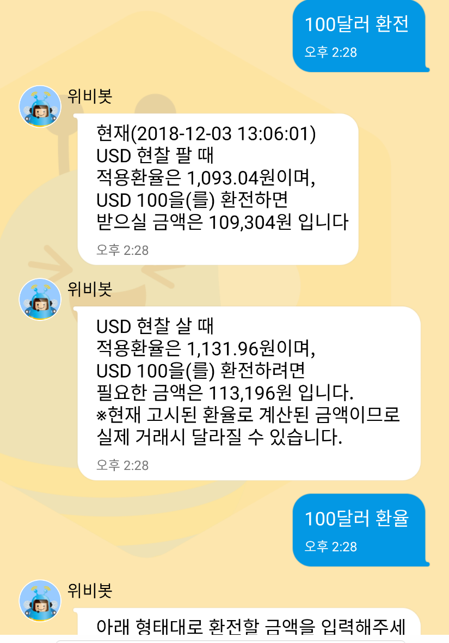
Motivation
Chatbots have to answer similarly for inputs having similar meaning.
Also, they somehow have to recognize not a full sentence, even with broken grammar or some typos/abbreviations.
Currently, some chatbots cannot do that.
← Succeed to ask 환전 (exchange), but failed to ask 환율(exchange rate)
This chatbot cannot recognize neither context nor similar words.
Acts same as previous slide

Slide 5

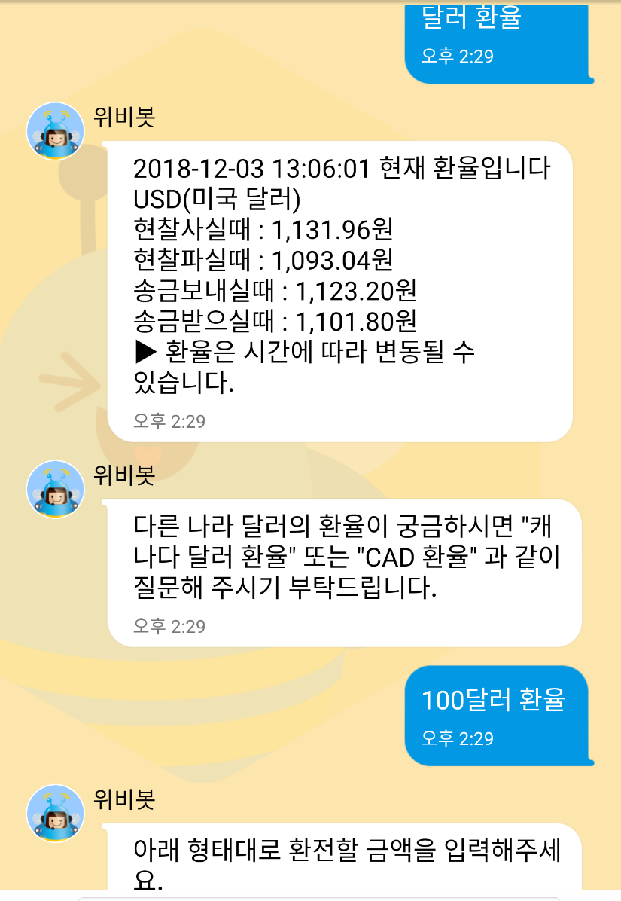
Motivation
Performance of some chatbot is awkward
← After asking 미국 환율 (dollar exchange rate), asking 중국은? (What about china?) makes failure to get an answer
← Succeed to ask 달러 환율 (dollar exchange rate), but failed to ask 100달러
This chatbot cannot recognize neither context nor similar usage.

Slide 6
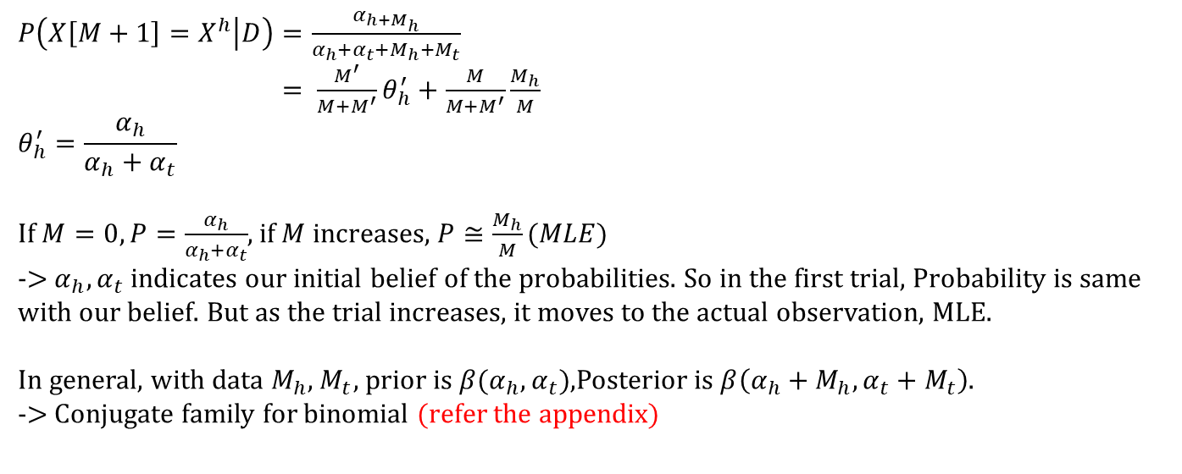
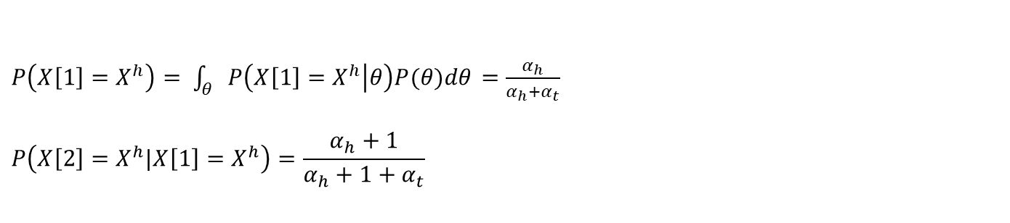
Lecture Note
9/12 Group 1
$P\left(X\left[1\right]=X^{h}\right)= \int_{θ}{P\left(X\left[1\right]=X^{h} | θ\right)P(θ)dθ}$ $=\frac{α_{h}}{α_{h}+α_{t}}$
$$P\left(X\left[2\right]=X^{h}|X\left[1\right]=X^{h}\right)=\frac{α_{h}+1}{α_{h}+1+α_{t}}$$
$P\left(X\left[M+1\right]=X^{h} | D\right)=\frac{α_{h+M_{h}}}{α_{h}+α_{t}+M_{h}{+M}_{t}}$
$= \frac{M^{′}}{M+M^{′}}θ_{h}^{′}+\frac{M}{M+M^{′}}\frac{M_{h}}{M}$
$$θ_{h}^{′}=\frac{α_{h}}{α_{h}+α_{t}}$$
If $M=0, P=\frac{α_{h}}{α_{h}+α_{t}}$, if$M$ increases, $P≅\frac{M_{h}}{M}(MLE)$
-> $α_{h}, α_{t}$ indicates our initial belief of the probabilities. So in the first trial, Probability is same with our belief. But as the trial increases, it moves to the actual observation, MLE.
In general, with data $M_{h}\text{,}{ M}_{t}$, prior is $β(α_{h},α_{t})$,Posterior is $β\left(α_{h}+M_{h},α_{t}+{ M}_{t}\right)$.
-> Conjugate family for binomial (refer the appendix)
$(M=M_{h}+M_{t}, { M}^{′}=α_{h}+α_{t}$)

Slide 7
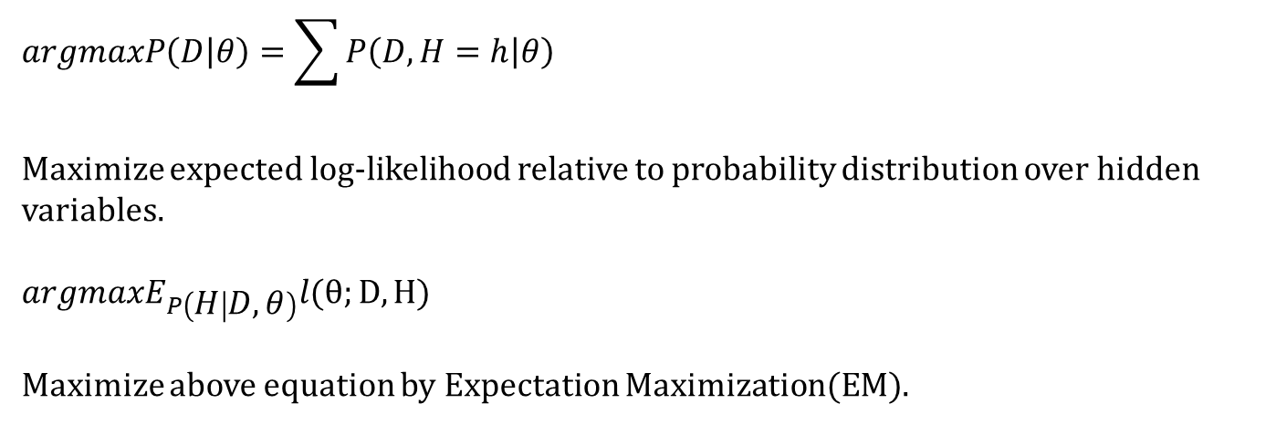

Lecture Note
9/12 Group 1
$$argmaxP\left(D | θ\right)=\sum{P\left(D,H=h | θ\right)}$$
Maximize expected log-likelihood relative to probability distribution over hidden variables.
$$argmaxE_{P\left(H | D,θ\right)}l(θ;D,H)$$
Maximize above equation by Expectation Maximization(EM).
Example)
$D: A=1, B=1 6 times$
$A=1, B=0 4 times$
$P\left(A=1 | H=0\right)=\frac{M(A=1, H=0)}{M(H=0)}$
H
A
B

Slide 8
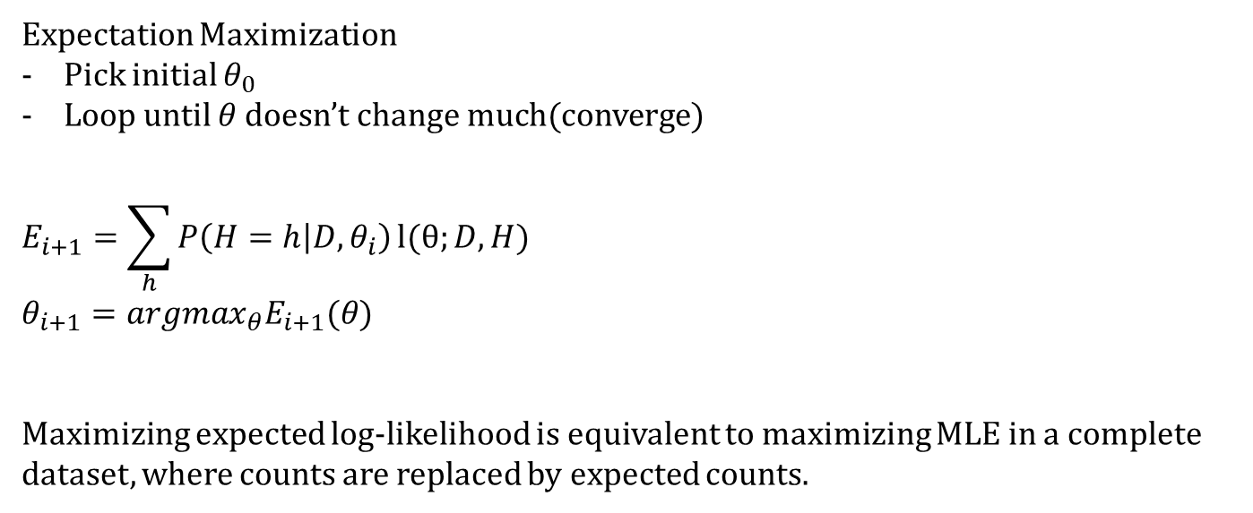
Lecture Note
9/12 Group 1
Expectation Maximization
Pick initial $θ_{0}$
Loop until $θ$ doesn’t change much(converge)
$$E_{i+1}=\sum_{h}{P\left(H=h | D,θ_{i}\right)}l(θ;D,H)$$
$$θ_{i+1}={argmax}_{θ}E_{i+1}(θ)$$
Maximizing expected log-likelihood is equivalent to maximizing MLE in a complete dataset, where counts are replaced by expected counts.

Slide 9
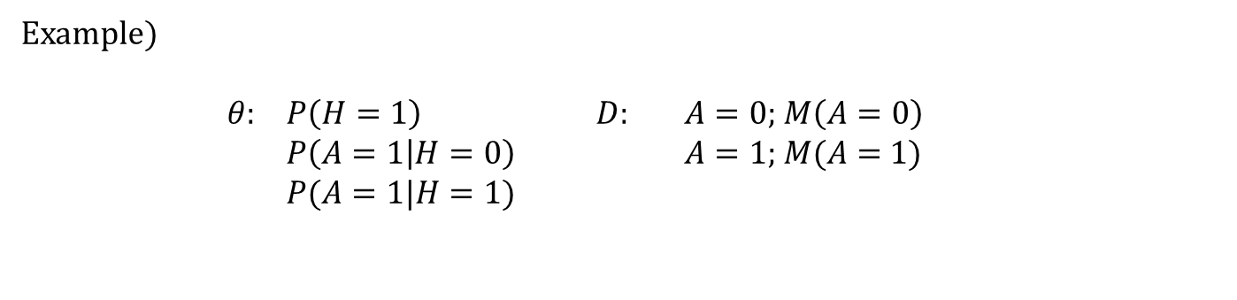
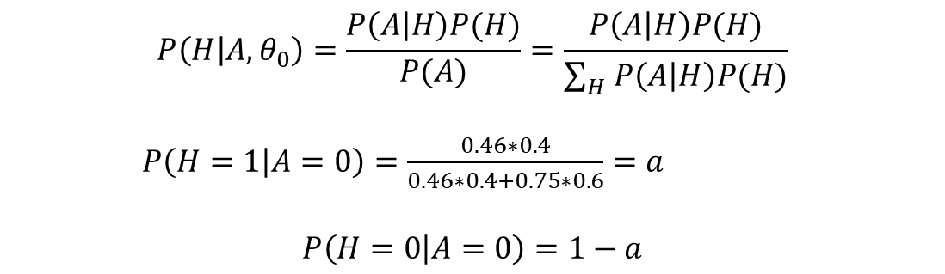
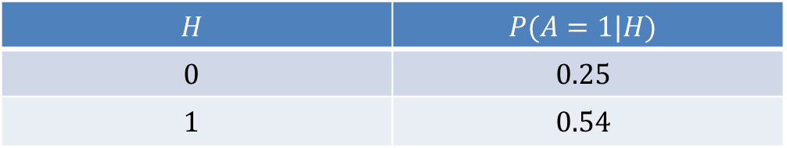

Lecture Note
9/12 Group 1
Example)
$θ$: $P\left(H=1\right)$ $D$: $A=0;$ $M\left(A=0\right)$
$P\left(A=1 | H=0\right)$ $A=1;$ $M(A=$ $1)$
$P(A=1|H=1)$
H
$θ_{0}; P\left(H=1\right)=0.4$
A
$$H$$ | $$P(A=1|H)$$
$$0$$ | $$0.25$$
$$1$$ | $$0.54$$
$$P\left(H | A,θ_{0}\right)=\frac{P\left(A | H\right)P(H)}{P(A)}=\frac{P\left(A | H\right)P(H)}{\sum_{H}{P\left(A | H\right)P(H)}}$$
$P\left(H=1 | A=0\right)=\frac{0.46∗0.4}{0.46∗0.4+0.75∗0.6}=a$
$$P\left(H=0 | A=0\right)=1−a$$

Slide 10

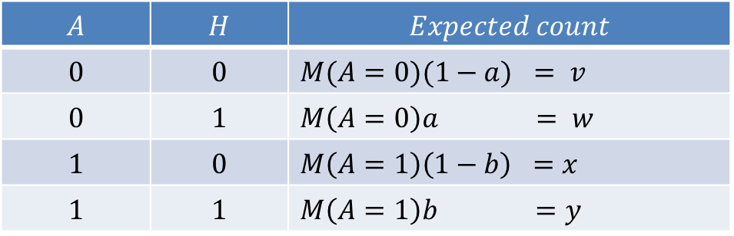
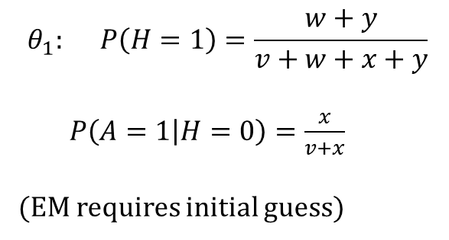
Lecture Note
9/12 Group 1
$$A$$ | $$H$$ | $$Expected count$$
$$0$$ | $$0$$ | $M(A=0)(1−a) = v$
$$0$$ | $$1$$ | $M\left(A=0\right)a = w$
$$1$$ | $$0$$ | $M\left(A=1\right)\left(1−b\right) =x$
$$1$$ | $$1$$ | $M\left(A=1\right)b =y$
$$θ_{1}: P\left(H=1\right)=\frac{w+y}{v+w+x+y}$$
$P\left(A=1 | H=0\right)=\frac{x}{v+x}$
(EM requires initial guess)
Log-
likelihood
# of step
General phenomena of EM
There are some plateaus
Monotonic improvement is guaranteed

Slide 11
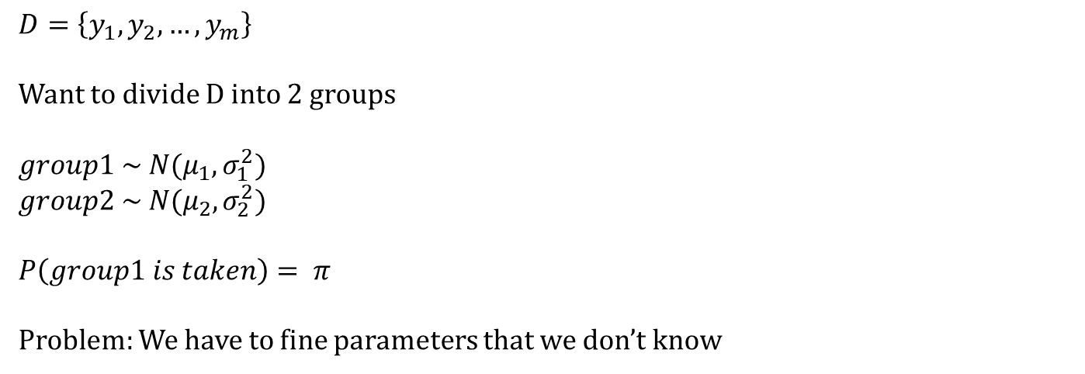
Lecture Note
9/12 Group 1
$D=\left\{y_{1},y_{2},…,y_{m}\right\}$
Want to divide D into 2 groups
$group1 \sim N(μ_{1},σ_{1}^{2})$
$group2 \sim N(μ_{2},σ_{2}^{2})$
$P\left(group1 is taken\right)= π$
Problem: We have to fine parameters that we don’t know

Slide 12
Additional Materials

Slide 13
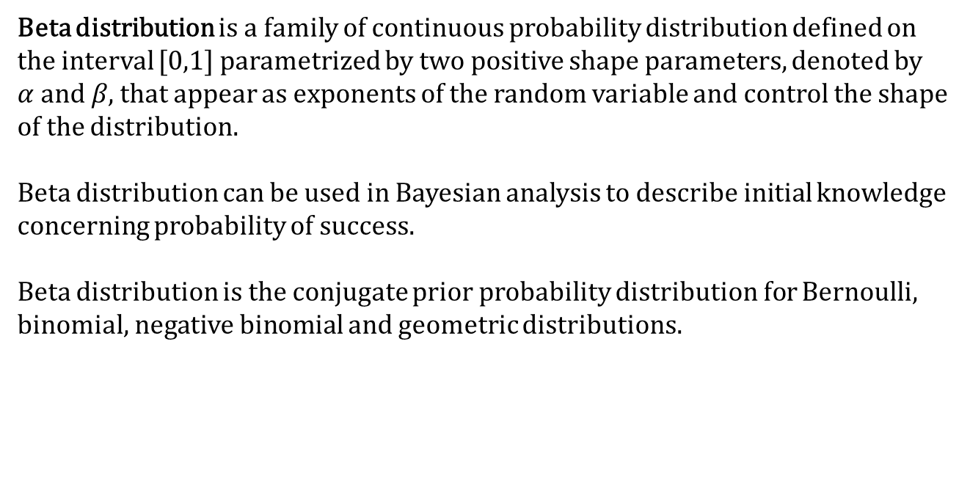
Additional Material
9/12 Group 1
Beta distribution
Beta distribution is a family of continuous probability distribution defined on the interval [0,1] parametrized by two positive shape parameters, denoted by $α \text{and} β$, that appear as exponents of the random variable and control the shape of the distribution.
Beta distribution can be used in Bayesian analysis to describe initial knowledge concerning probability of success.
Beta distribution is the conjugate prior probability distribution for Bernoulli, binomial, negative binomial and geometric distributions.
Notes:
and

Slide 14
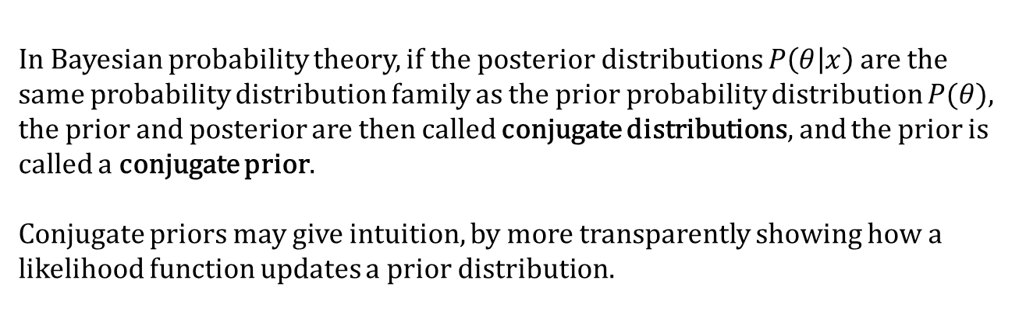
Additional Material
9/12 Group 1
Conjugate Prior
In Bayesian probability theory, if the posterior distributions $P\left(θ | x\right)$ are the same probability distribution family as the prior probability distribution $P(θ)$, the prior and posterior are then called conjugate distributions, and the prior is called a conjugate prior.
Conjugate priors may give intuition, by more transparently showing how a likelihood function updates a prior distribution.
Notes:
and

Slide 15
Additional Material
9/12 Group 1
Expectation Maximization
Expectation-Maximization algorithm(EM) is an iterative method to find maximum likelihood or maximum a posteriori estimates of parameters in statistical models, where the model depends on unobserved latent variables.
The EM iteration alternates between performing an expectation step, and maximization step.
Expectation step creates a function for the expectation of the log-likelihood evaluated using the current estimate for the parameters.
Maximization step computes parameters maximizing the expected log-likelihood found on the Expectation step.
Notes:
and

Slide 16
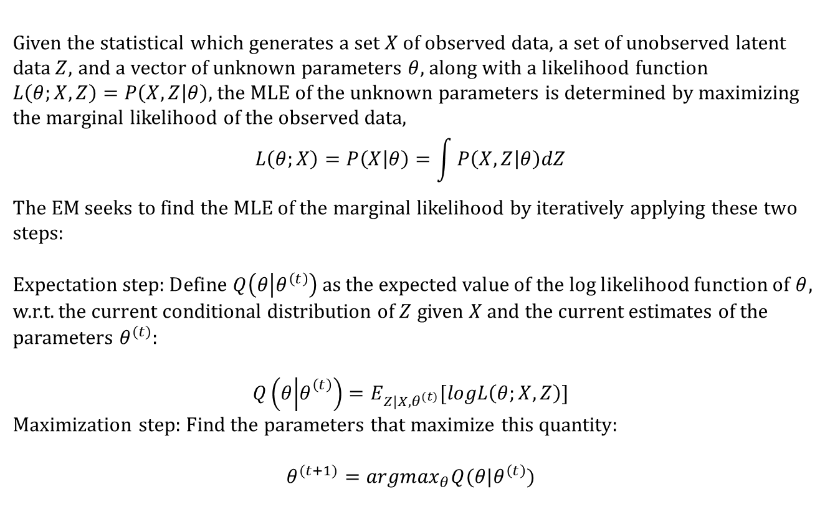
Additional Material
9/12 Group 1
Expectation Maximization
Given the statistical which generates a set $X$ of observed data, a set of unobserved latent data$Z$, and a vector of unknown parameters $θ$, along with a likelihood function $L\left(θ;X,Z\right)=P\left(X,Z | θ\right),$the MLE of the unknown parameters is determined by maximizing the marginal likelihood of the observed data,
$$L\left(θ;X\right)=P\left(X | θ\right)=\int{P\left(X,Z | θ\right)dZ}$$
The EM seeks to find the MLE of the marginal likelihood by iteratively applying these two steps:
Expectation step: Define $Q\left(θ | θ^{\left(t\right)}\right)$as the expected value of the log likelihood function of $θ$, w.r.t. the current conditional distribution of $Z$ given $X$ and the current estimates of the parameters $θ^{(t)}$:
$$Q\left(θ | θ_{}^{\left(t\right)}\right)=E_{Z|X,θ^{(t)}}[logL\left(θ;X,Z\right)]$$
Maximization step: Find the parameters that maximize this quantity:
$$θ^{(t+1)}={argmax}_{θ}Q(θ|θ^{\left(t\right)})$$
Notes:
and

Slide 17
Appendix

Slide 18

Appendix
9/12 Group 1
Proof for posterior:
$$P\left(θ | D\right)∝P\left(D | θ\right)p\left(θ\right)$$
$$=\left({M_{h}+M_{t} \atop M_{h}}\right)θ^{M_{h}}{\left(1−θ\right)}^{M_{t}}{\frac{Γ(α_{h}+α_{t})}{Γ(α_{h})Γ(α_{t})} θ}^{α_{h}−1}{\left(1−θ\right)}^{α_{t}−1}$$
$$∝θ^{M_{h}+α_{h}−1}{\left(1−θ\right)}^{M_{t}+α_{t}−1}$$
$\sim β(M_{h}+α_{h},M_{t}+α_{t}$) $∎.$

Slide 19
References
9/12 Group 1
References
https://en.wikipedia.org/wiki/Beta_distribution
https://en.wikipedia.org/wiki/Conjugate_prior
https://en.wikipedia.org/wiki/Expectation%E2%80%93maximization_algorithm
Notes:
and

